Slide 1

Waste
As
Resource by changing
Stakeholders’
Approach
WARSA
REPORT LAUNCH EVENT

Slide 2


ABOUT POLICY ADVOCACY RESEARCH CENTRE
Policy Advocacy Research Centre, India (PARC) is an independent think-tank and socio-economic development-oriented implementation agency engaged in progressive impact-driven policy development.
PARC engages with members of the Central/State Governments, Bureaucracy, Corporates, Industry Bodies, domain experts, academicians, NGOs, and other concerned institutions and individuals to form, evaluate and revise various policies affecting society and evaluate them based on the interest of the nation and citizens.
PARC drives a range of projects in the national & state contexts, underpinned by MoU’s collaborating with governments, institutions, industry bodies, etc., wherein these projects have outcomes that empower the community, the economy, and society.

Slide 3
WHY WE FOCUS ON SOLID WASTE MANAGEMENT
The ‘Solid Waste Management Sector’, with huge opportunities, currently faces immense challenges to streamline the end-to-end solid waste value chain operations and reverse logistics. When we analysed the sector through 5 ‘WHY’ analysis and interacted with many eminent experts in the sector, and value chain stakeholders, we realized the need of the stakeholder-centric, inclusive research to establish dialogue between the interlinked but collaboratively distinct but interdependent stakeholders.
This report is an outcome of the vision to address solid waste management through streamlining interlinkages between human & technological resources effectively.

Slide 4

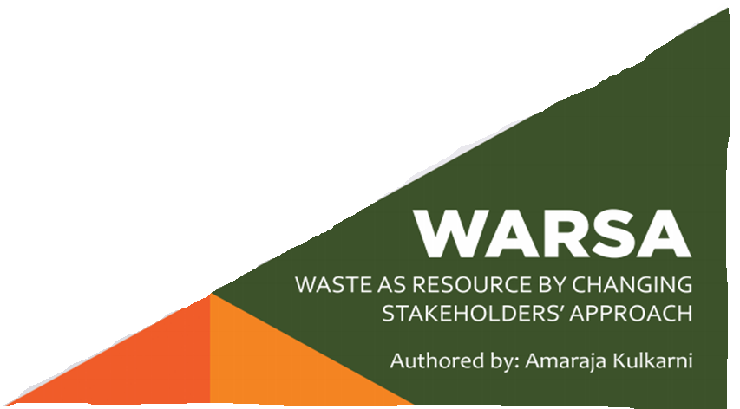
PARC’S INITIATIVE TOWARDS BRINGING POSITIVE CHANGE

Slide 5
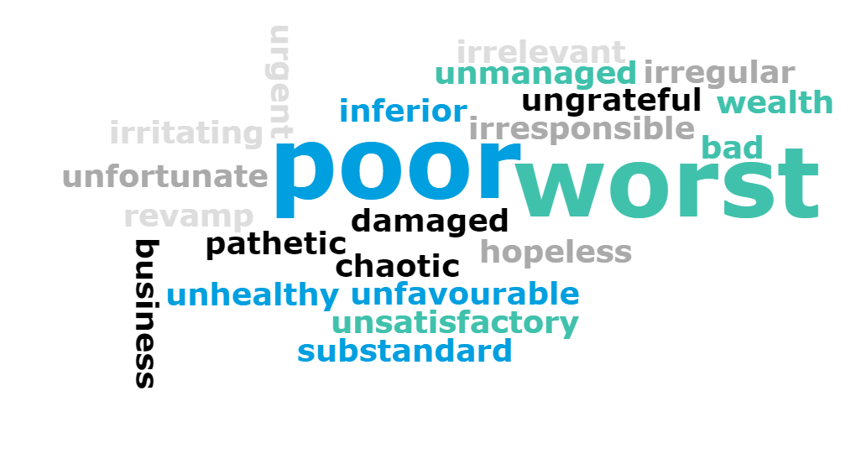
In single word, describe the current status of the solid waste management in India.
Live Polling Results Question 1
Meeting attendees agree that this is a problem which needs to addressed on priority.
Vote Trigger

Slide 6





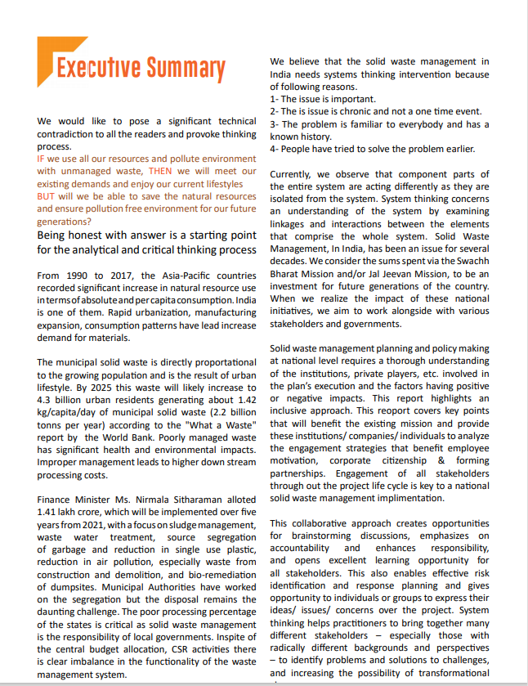



REPORT OVERVIEW
TARGETS STRENGTHEING WASTE MANAGEMENT SECTOR THROUGH SYSTEMS THINKING
Lists challenges and barriers in the sector Mentions notable examples, strategies Highlights opportunities..
Encourages a fair dialogue among stakeholders to achieve the synergies.
Maps stakeholders. Proposes the inclusion strategies
Emphasizes institutional coherence and cross –sector collaborations..
Analyses the gaps in current system
Envisages the stakeholder driven sectoral policies.
Proposes new policy vision to streamline the waste management sector .
Reviews current scenario in the waste management sector
1
2
3

Slide 7
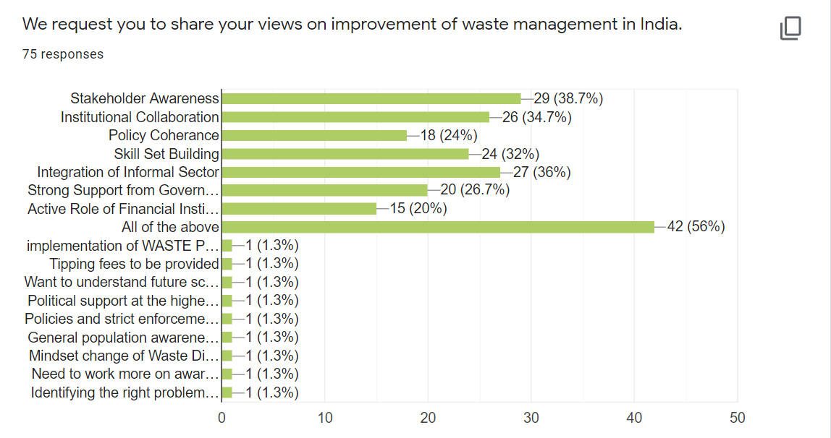
Results as on Date- 24.09.2021, Time- 12.00 AM!

Slide 8
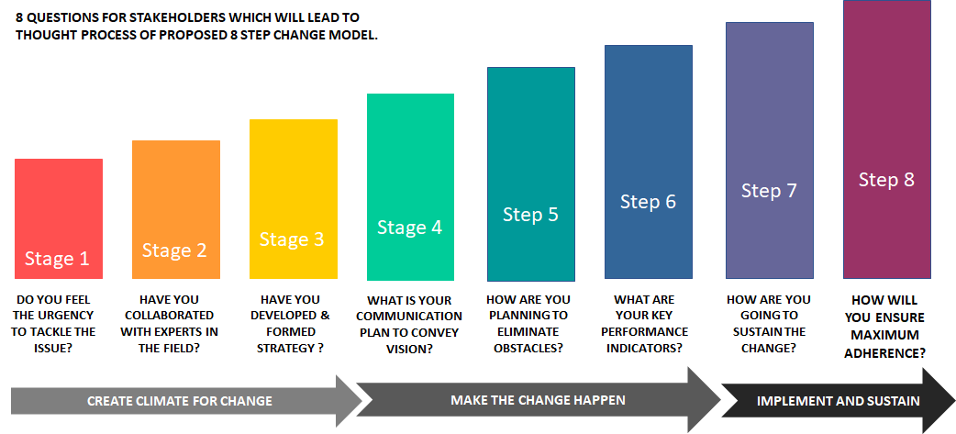

Slide 9
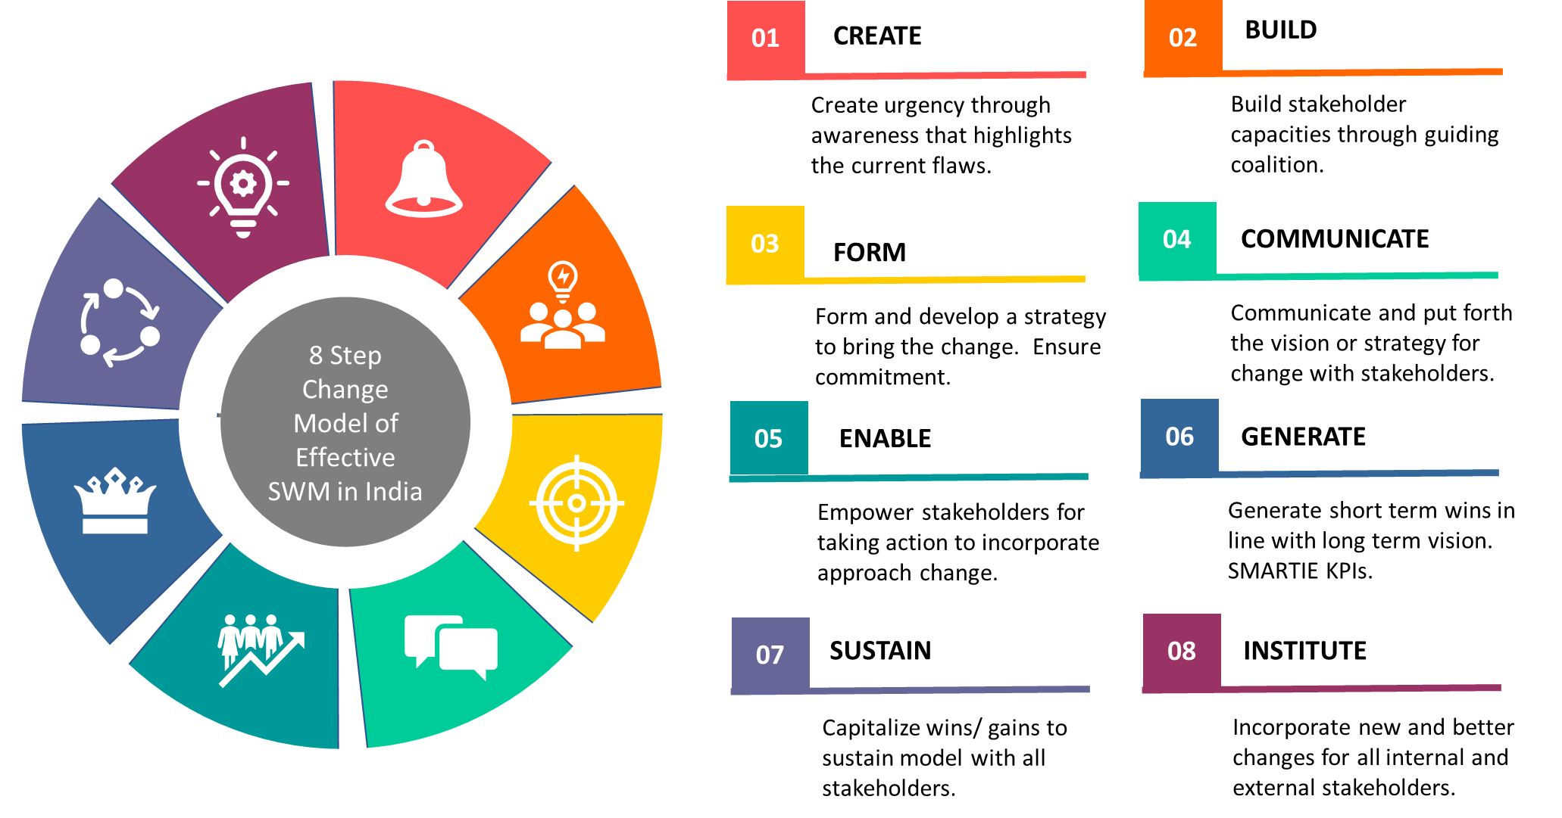
PROPOSED MODEL TO STREAMLINE SOLID WASTE MANAGEMENT SECTOR

Slide 10


GAME CHANGING STRATEGY
INNOVATORS
MARKET DYNAMICS
SUPPORT SOLUTIONS PROVIDERS WHO HAVE POTENTIAL TO SOLVE THE PROBLEMS
UNDERSTAND UNMET NEEDS AND EMPOWER TO TAP THE POTENTIAL
INNOVATORS
MARKET
ORGANIZATIONAL GOVERNANCE
STAKEHOLDER SUPPORT
COLLABORATING WITH STAKEHOLDERS TO CREATE SYNERGIES
BRING ABOUT THE CHANGE IN STAKEHOLDERS APPROACH IN EVERY ESTABLISHMENT-EVEN HOME!
SUPPORT
ORGANIZATIONAL GOVERNANCE
ALIGNED ACTIONS
GOALS
PLANNING STEPS THAT ALIGNS WITH EVERY STAKEHOLDER’S INTEREST
GOALS
CREATE SHORT TERM WINS TO ACHIEVE LONG TERM VISION
STEPS
DATA
DATA DRIVEN APPROACH
PROPER FACTBASED DECISIONS THROUGH UNBIASED DATA

Slide 11
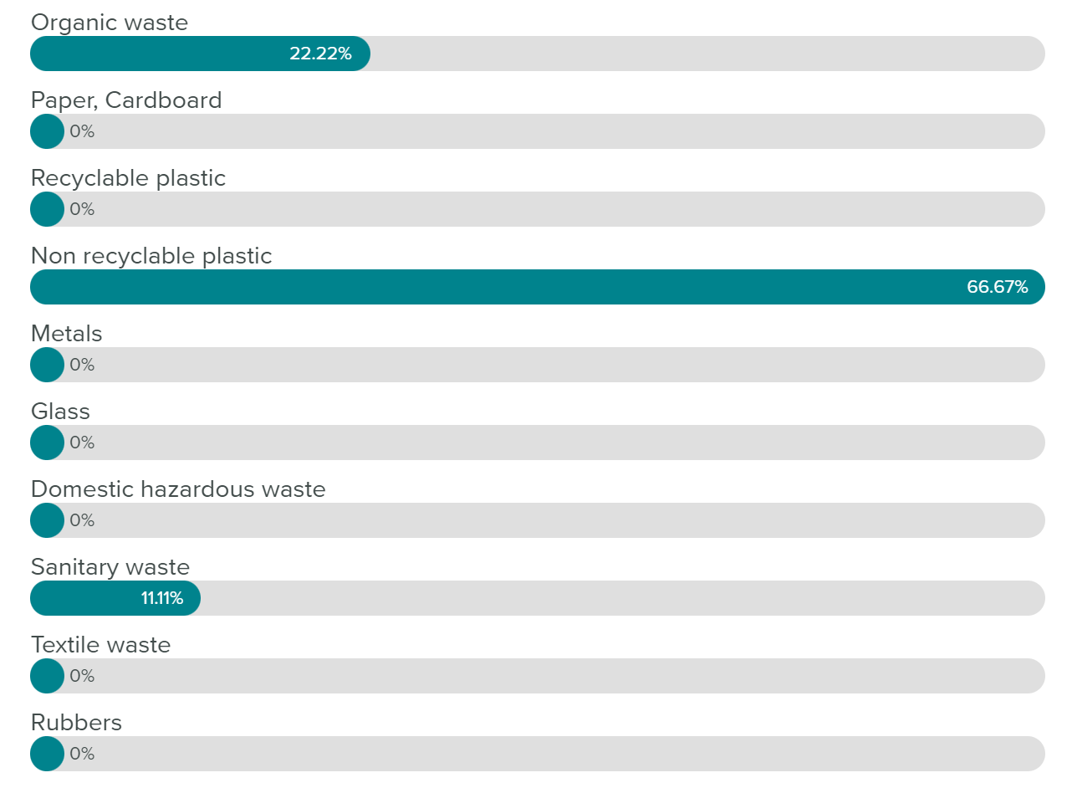
In the components of solid waste, which one has a major impact on the environment according to you?
Live Polling Results Question 2
This will help us in future research.
Vote Trigger

Slide 12
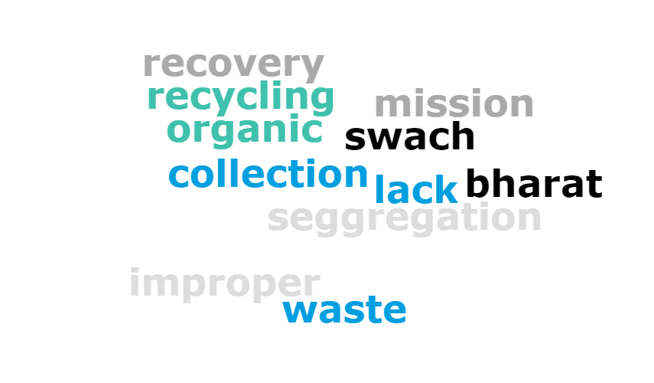

List at least one gap in streamlining the solid waste management sector.
Live Polling Results Question 3
These were the gaps we were initially thinking but then we realized, the gaps are wider.
Vote Trigger

Slide 13

MAJOR GAPS IN STREAMLINING SECTOR
15
|INSTITUTIONAL PRO-ACTIVENESS |
| COLLABORATION AND COMMUNICATION|
|ADMINISTRATIVE FRAMEWORKS|
|INFRASTRUCTURE|
|NATIONAL POLICY|
|STRATEGIC
PLANNING|
|FINANCIAL
SUPPORT|
|ADMINISTRATIVE
WILLINGNESS|
|LEGAL SUPPORT AND FRAMEWORKS|
|CITY PLANNING|
|EFFECTIVENESS AT
MUNICIPAL LEVELS|
|CORPORATE RESPONSIBILITY|
|PUBLIC
PARTICIPATION|
|PARTNERSHIPS|
|VISION|
|EXECUTION|

Slide 14
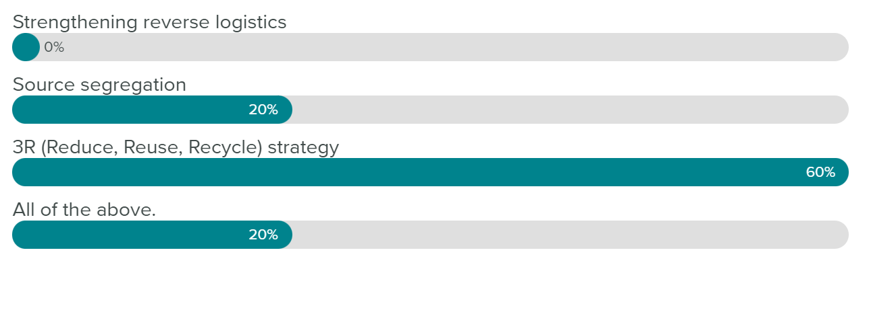
Which one according to you, will be the triggering factor for maximum resource recovery from solid waste in India?
Live Polling Results Question 4
According to us, strengthening of reverse logistics is also essential for the circular economy initiatives.
Vote Trigger

Slide 15
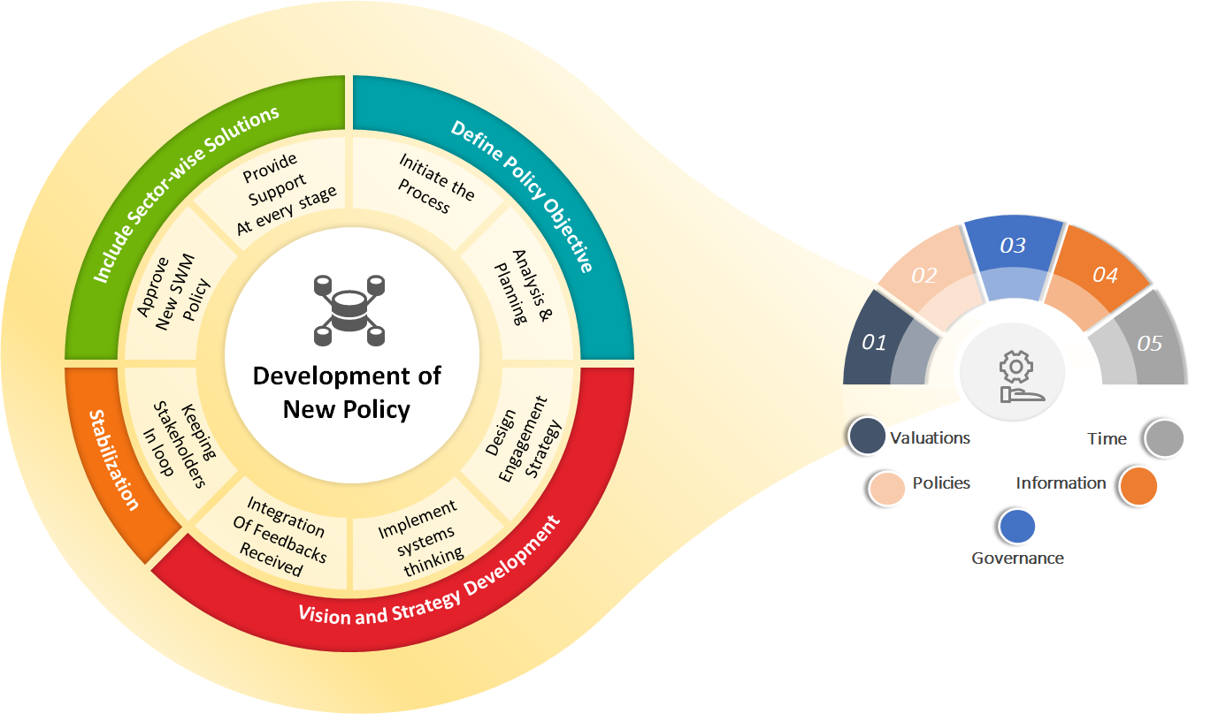
POLICY VISION PROPOSED BY PARC

Slide 16
PARC’s PRIORITY ENGAGEMENTS
Exploring WAYS TO increase the policy adherence and reduce the compliance barriers.
TECHNOLOGY MAPPING
Achieving Synergies
Increasing Stakeholders’ Interest
Decision That DRIVES CHANGE
DATA
Write to us for engaging with PARC on warsa@parcfornation.org

Slide 17
PARC’s FOCUS POINTS
DATA TRANSPERANCY
CROSS-SECTOR COLLABORATION
RESEARCH FOR SECTORAL INTERVENTIONS
IMPACTFUL CAMPAIGNS
TECHNOLOGY MAPPING
REGULATORY INTERVENTIONS
DATABASE CREATION
GOVERNANCE SUPPORT

Slide 18





WARSA Pre-launch Event Engagement Analysis
Total Email Outreach For the project
Pre-Launch Report Access Registrations
Guest Report Access (Advisories and Speakers)
Launch Event Registrations
500
75
26
179
Which Were
Converted into

Slide 19
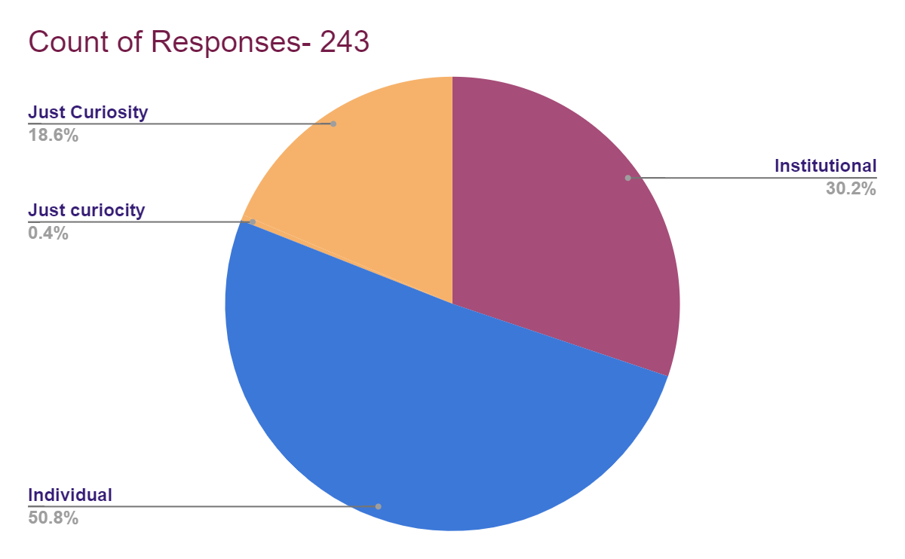
Engagement Willingness From Participants

Slide 20
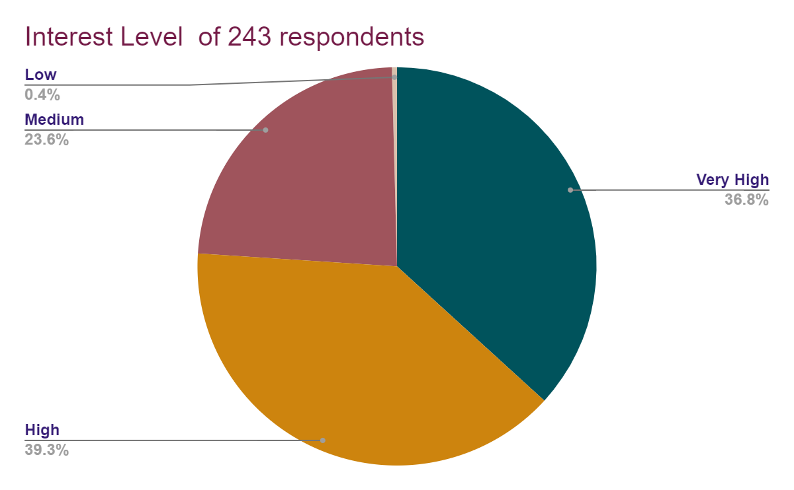
Participants’ Interest Levels

Slide 21
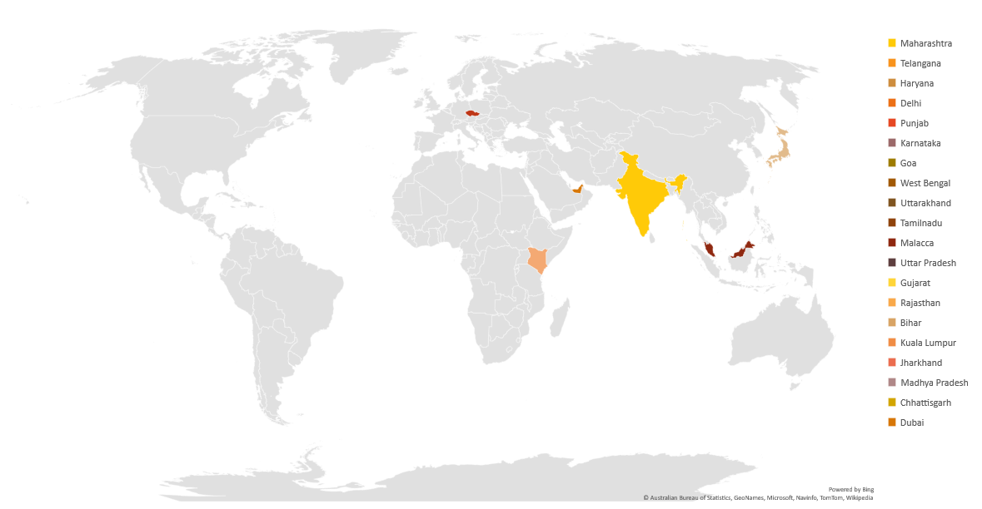
Engaged Participants’ Geographies
In this initial phase we could engage with 7 Different countries, 19 Indian States, 3 Union Territories of India.

Slide 22
Policy Advocacy Research Centre,(PARC) India would like to initiate structured dialogue between all stakeholders to strengthen the waste management sector.
THANK YOU
Write to us for engaging with PARC on
warsa@parcfornation.org

